Slide 1
DriverPass System Analysis
Rylan Champion
Notes:
[No speaker notes required for this slide.]

Slide 2

System Requirements
NonFunctional:
•The software will be web-based ran on Linux.
•Each user will be able to create an account that will be case-sensitive with multi-factor authentication for safety.
Functional:
Users will be able to purchase packages and schedule lessons.
Users will be able to take practice tests and schedule driving practice.
Notes:
The nonfunctional requirements that I have chosen to focus on is because making sure the platform works well on web browsers and Linux servers is important for reaching as many users as possible and ensuring reliable performance. This broad accessibility and stable platform build trust and satisfaction among users, which will contribute to DriverPass's success.
Security Measures Implementing strong security measures like multi-factor authentication is essential for keeping users' information safe and building trust as well. By prioritizing their security, we create a safe environment that encourages long-term engagement and loyalty, crucial for DriverPass's ongoing loyal customer support.
For the Functional requirements we prioritize user account management to make sure users can access the platform securely. By letting users create accounts with unique IDs and adding extra security layers like multi-factor authentication, we build trust and keep their information safe, which is keyin our day and age.
Package Purchase and Lesson Scheduling Allowing users to buy packages and schedule lessons directly within the platform is crucial for making their experience easy and convenient. This feature simplifies the process, making it more likely for users to stick with DriverPass and recommend it to others.
Finally Practice Tests and Driving Practice Scheduling Offering practice tests and the ability to schedule driving sessions helps users prepare thoroughly for their license tests. By giving them tools to build confidence and skills, we increase their chances of success, leading to happier users and positive referrals, as well as just being the main reason for this website.

Slide 3
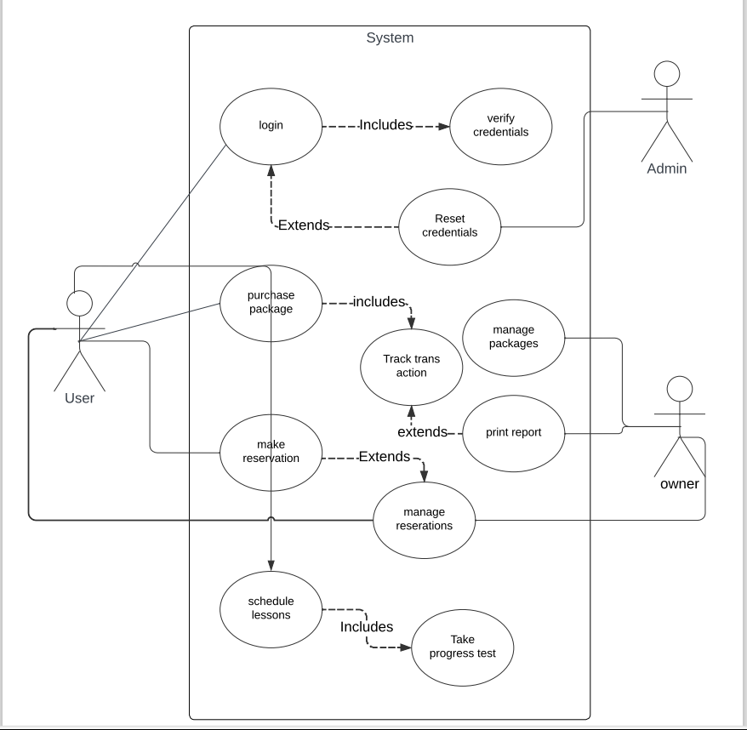
Use Case Diagram
Notes:
The use case diagram shows 3 users the customer, owner and the admin.
The admin will have the capabilities to reset credentials of users who are having issues logging in or forgotten their account.
The owner will have access to the data of the system being able to print out reports of the site and manage and change the packages. Along with manage all the reservations of customers.
The customer will have access to the site through their user account. They can login and change their account if needed. They can purchase a package and schedule a reservation. They an also schedule a lesson and the system will assign them an available teacher. Then they can take a progress test aswell.

Slide 4
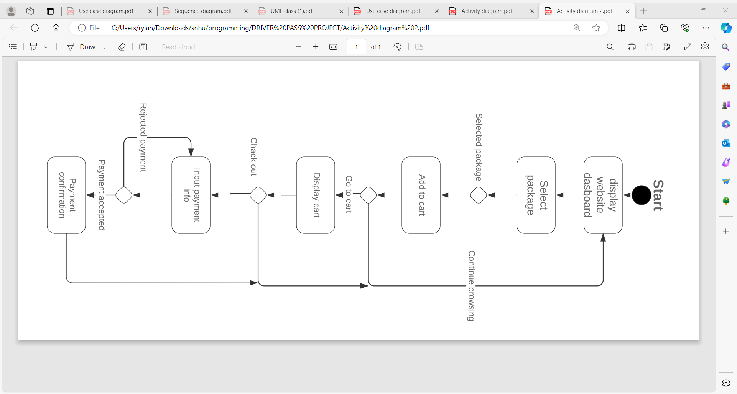
Activity Diagram
Notes:
The use case I'm presenting illustrates the process of purchasing a package on our platform.
User starts by logging in, and the website displays the dashboard.
User selects a package to purchase, which is then added to the cart.
User has the option to continue browsing or proceed to the cart.
Upon entering the cart, the site displays the items selected and the subtotal.
User proceeds to checkout, where the system verifies payment details. If any information is incorrect, users are prompted to make necessary changes.
Once payment is confirmed, the system processes the transaction and sends a notification of payment confirmation to the user.

Slide 5
Security
Unique usernames that are case-sensitive.
Encrypted database for user information
Admins have powers over accounts so they can change or remove them if there are issues.
Will use a cloud-based operating system.
Notes:
Ensuring Security:
We made sure that usernames and passwords are unique and case-sensitive, which helps keep users' information safe and private. This also allows users to easily track their progress and buy packages whenever they need to.
Sensitive information like usernames, passwords, and other data are stored in a secure, encrypted database. This keeps the information protected and allows administrators to track users, their progress, and their purchases without risking exposure.
Administrators can modify or remove users who pose a security risk. For example, if a user has multiple failed login attempts and doesn't reset their password, it could indicate a potential hacking attempt. This proactive approach helps prevent unauthorized access and protects users from potential harm.
Our top priority is ensuring the security of our users' information.
We use a cloud-based operating service for hosting, and all files stored on our cloud servers are encrypted. This means that the data is scrambled, making it extremely difficult for cybercriminals to access. This extra layer of security helps safeguard our users' data and maintain their trust in our platform.

Slide 6
System Limitations
Making changes to packages in requires developer assistance, which may increase costs.
We use third-party services for financial transactions, leading to additional expenses due to startup and monthly fees.
Internet access is necessary for system use, posing challenges if instructors encounter areas with no connectivity and need to adjust schedules.
Notes:
Making changes to features like "packages" in DriverPass isn't something non-developers can handle easily. It involves a lot of technical stuff that only developers understand. So, whenever we want to change how packages work, we must get help from developers to make sure everything works correctly.
Instead of handling money matters ourselves, like processing credit card payments, we rely on other companies to do it for us. While this means we have to pay them, it's simpler and cheaper than creating our own payment system, which would be really complicated and expensive.
DriverPass relies on the internet for everything to work smoothly. This means you must be connected to the internet to use it. While it would be nice to use it without internet sometimes, making that work properly is really hard and would make things more complicated. So, for now, internet access is a must.

